Slide 1
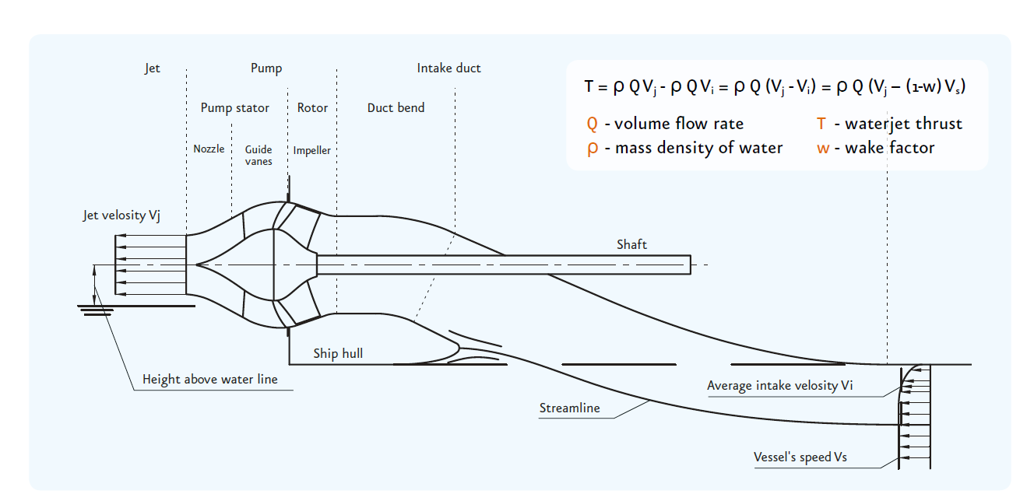
Thrust Theory
Thrust is created through accelerating water through the pump
And is related to Volume Flow Rate Q times Jet nozzle velocity V_{j} – Average intake velocity V_{i}
Wake field factor, w, adds to efficiency through V_{i} = (1-w) V_{s} where V_{s} is vessels speed
Wake factor, w, is related to waterline length
High flow, Q, rather than pressure creates a good thrust

Slide 2
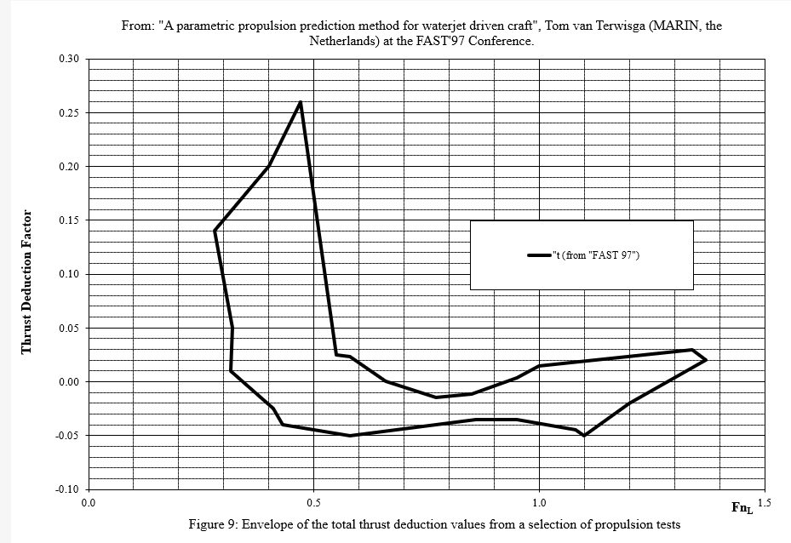
Thrust Theory
As a precaution MJP calculates the so-called thrust deduction factor t as zero.
The effect of thrust deduction (or negative thrust deduction factor) is hull related and cannot generally be accounted for.

Slide 3
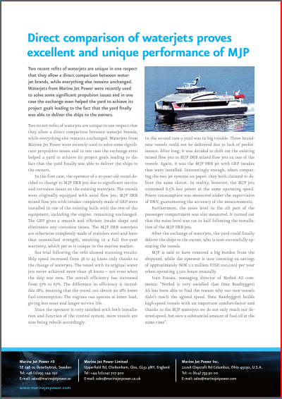
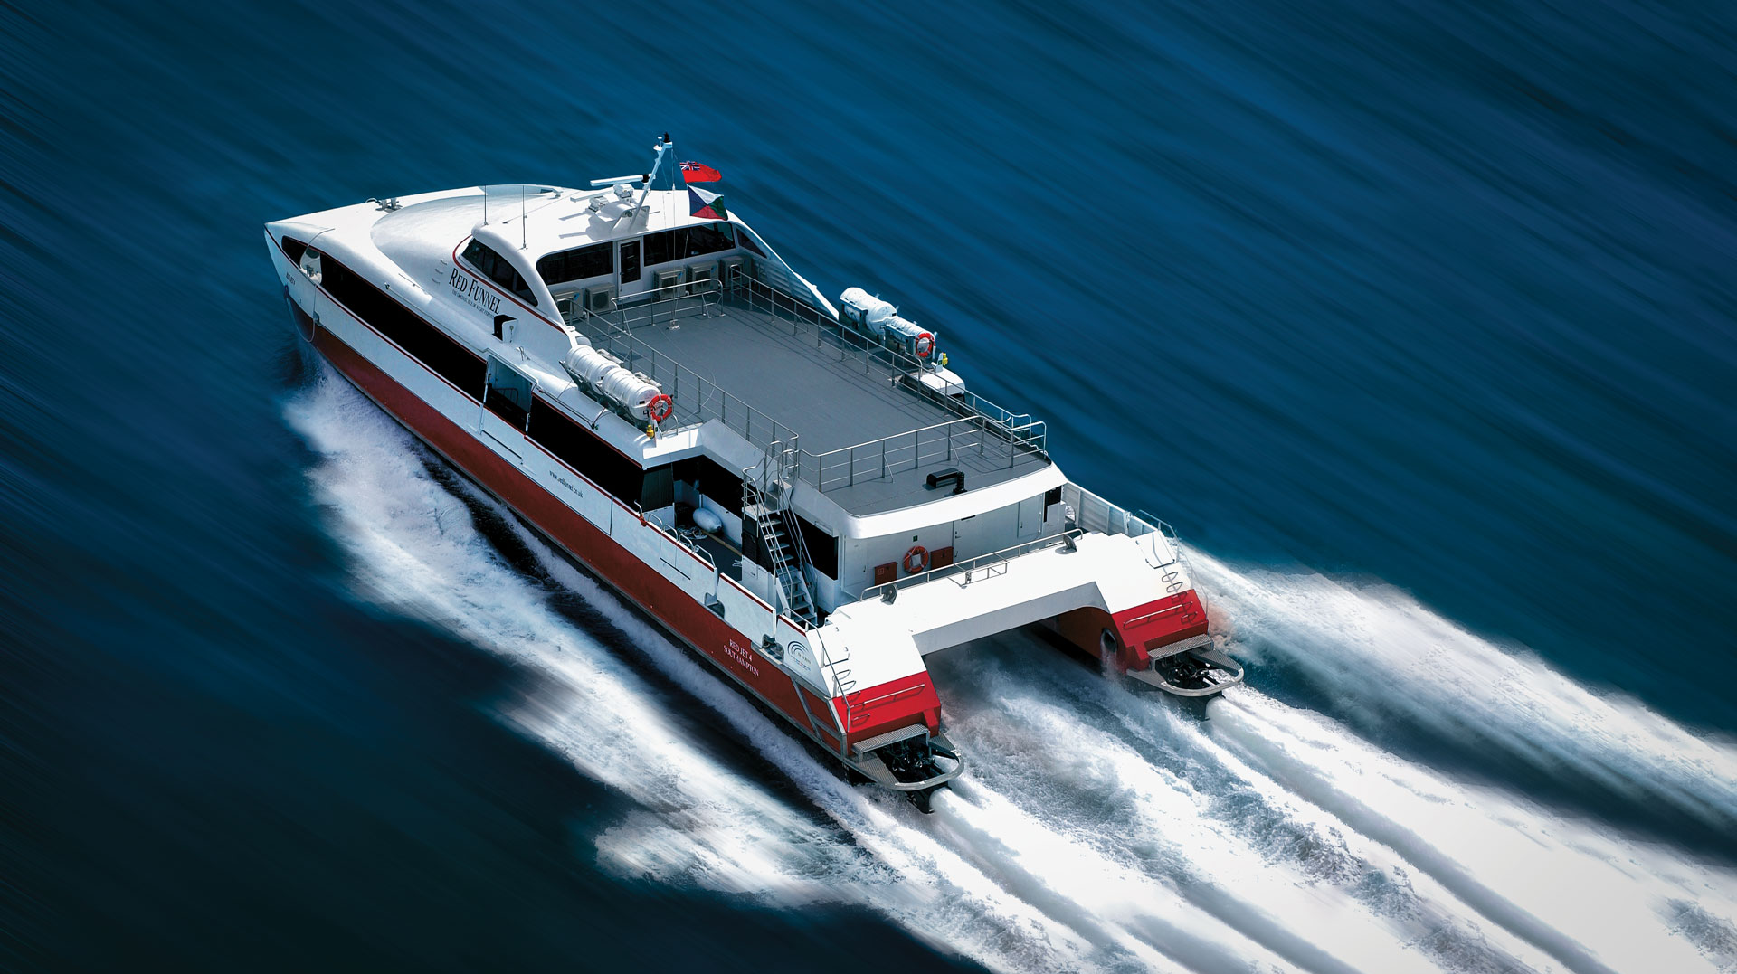
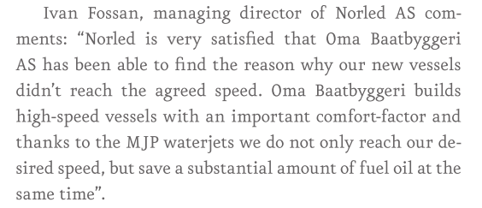
Better Performance
“We believe that on performance MJP are the best in the market! They actually deliver the promised speed”
John Bonafoux, BMT Nigel Gee
“MJP is a victim of their own modesty and also bullshit from other OEMs on performance and efficiency”
Henk van Herwijnen, General Manager, CoCo Yachts,
Testimony – 10% measured difference measured and confirmed by DNV-GL

